Slide 1
BITS ZG553: Real Time Systems [L6a – Performance, Optimality, Schedulability]
K G Krishna
WILP Division, BITS-Pilani, Hyderabad

Slide 2


Text Book / References
Reference (R1)
Text Book (T1)
Note: As the above two books focus on theoretical treatment of the subject, Students are strongly advised to refer to web sources / MOOCs videos / library within their own organizations for more practical understanding of the topics.

Slide 3
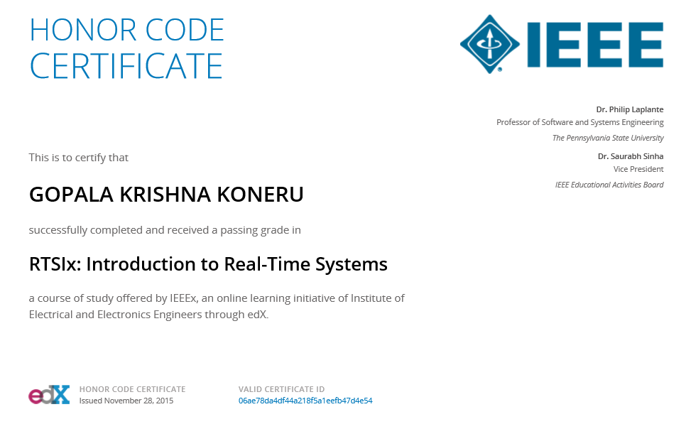
Excellent MOOCs Videos
(Coursera, edX,…)

Slide 4

RTS Primer – For Light Reading

Slide 5
L-6: Review of Common RTS Schedulers -
[/w Functional/Temporal Parameters, Feasibility & Optimality]
Ref: T1]
Note: Students are requested to NOT to rely on PPTs/Recorded sessions as their only source of knowledge, explore sources within your own organization or web for any specific topic; attend classes regularly and involve in discussions;
PLEASE DO NOT PRINT PPTs, Save the Environment!
Source PPT Courtesy: Some of the contents of this PPT is sourced from Presentatoons of Prof K R Anupa / Prof B Mishra, BITS-Pilani WILP Division

Slide 6
Three Approaches
Clock-driven
Round-robin / Weighted round-robin
Priority-driven

Slide 7
Clock-driven Approach
Scheduling decisions are made at specific time instants, which are chosen a priori before the system begins execution
Typically this type of scheduling is suitable for hard real-time systems, where the parameters are fixed and known.
Scheduling decisions are computed off-line and stored for use at run-time, thus scheduling overhead is minimal.
Generally a hardware time is set to expire periodically.
After the system gets initialized, the scheduler selects and schedules jobs which execute till the next scheduling decision is made. Then the scheduler blocks itself waiting for the expiration of the timer.
When the timer expires, the scheduler wakes up, does necessary scheduling and sleeps again. This process repeats.

Slide 8
Round-robin Approach
Also known as time-sharing
Every job joins a FIFO (First-in-first-out) queue when it becomes ready for execution
The entire time period is divided into several time-slices
The job at the head of the queue executes for one time-slice.
If the job doesn’t complete at the end of the time-slice, it gets pre-empted and placed at the end of the queue to waits for its next turn.
If there are ‘n’ jobs ready for execution, each job gets 1/nth share of the processor.

Slide 9
Round-robin Approach - Example
 | J_{1,1} | J_{2,1} | J_{1,2} | J_{2,2} | J_{1,3} | J_{2,3}
time
(Round-robin execution of two tasks on a single processor)
P1 | J_{1,1} | J_{2,1}
P2 |  | J_{1,2} | J_{2,2}
J_{1,1}
J_{1,2}
J_{2,1}
J_{2,2}
time
(Round-robin execution of two tasks on two processors)

Slide 10
Weighted round-robin Approach
This approach is a round robin approach with different weights assigned to different jobs.
If a job has weight ‘wt’, then it will get ‘wt’ time slices every round for execution.

Slide 11
Priority Driven Approach
Also known as greedy scheduling, list scheduling and work-conserving scheduling
Priorities are assigned to the jobs based on their criticality
Jobs ready for execution are placed in one or more queues ordered by priorities of the jobs.
At any scheduling decision time, the jobs with the highest priorities are scheduled and executed on the available processors.
Most scheduling algorithms used in non-real-time systems are priority driven.
FIFO (First In First Out)
LIFO (Last In First Out)
SETF (Shortest Execution Time First)
LETF (Longest Execution Time First)
For jobs of same priority, round-robin scheduling is used

Slide 12
Priority-driven Scheduling Example
Rules:
each process has a fixed priority (1 highest);
highest-priority ready process gets CPU;
process continues until done.
Processes
J1: priority 1, release time 15, execution time 10
J2: priority 2, release time 0, execution time 30
J3: priority 3, release time 18, execution time 20

Slide 13
Priority-driven Scheduling Example
J3 ready t=18
J2 ready t=0
J1 ready t=15
J2
J1
J2
J3
0
10
20
30
40
50
60
time

Slide 14
Effective Release Time and Deadline
It may happen that a job has release time later than that of its successor and deadline earlier than that of its predecessor.
Hence it may not be useful to work with individual jobs release time and deadlines.
Effective Release Time
Effective Release Time of a job without any predecessor is its given release time.
Effective Release Time of a job with predecessors is maximum of its given release time and the effective release times of its predecessors.
Effective Deadline
Effective Deadline of a job without any successor is its given deadline.
Effective Deadline of a job with successors is minimum of its given deadline and the effective deadlines of its successors.
By release time and deadline, we will mean effective release time and effective deadlines respectively.

Slide 15
Off-line vs On-line scheduling
Off-line scheduling: When the schedule is pre-computed and kept, it is called off-line scheduling.
Example: Clock-driven scheduling
It is possible only when the system parameters are known a priori
Advantages: Deterministic timing behaviour, Lesser complexity, Very less scheduling overhead
On-line scheduling: When the scheduler makes each scheduling decision without knowledge about the jobs that will be released in the future
Example: Priority driven scheduling
It is the only option when future workload is unpredictable
The price of the flexibility and adaptability is a reduced ability for the scheduler to come up with an optimal schedule making the best use of the system resources

Slide 16
Priority Driven vs Clock Driven approaches
Priority driven approaches have many advantages compared to clock driven approach:
They don’t have to have the information on the release time, execution time etc (in contrast with clock driven approach, where these parameters are required to be known a priori)
It is best suited for applications with varying time and resource requirements
Many well-known priority –driven algorithms use very simple priority assignments reducing the overhead of maintaining multiple queues.
Despite all these advantages, Clock-driven approaches are used for hard real-time systems, especially in safety-critical systems.
The major reason is that the timing behaviour of a priority-driven system is nondeterministic when job parameters vary.
Consequently it is difficult to validate the deadlines of all the jobs in a priority-driven approach that they meet the deadline, when job parameters vary.

Slide 17
Overload condition
A system is said to be overloaded when the job offered to the scheduler can’t be feasibly scheduled by a clairvoyant scheduler.
When the system is not overloaded, an optimal on-line scheduling algorithm is one that always produces a feasible schedule of all offered job.
No optimal on-line scheduling algorithm exists when some jobs are non-preemptable.
During an overload, some jobs must be discarded in order to allow other jobs to complete on time.

Slide 18
EDF (Earliest Deadline First) Algorithm
Job with earliest (absolute) deadline has highest priority (Process closest to its deadline has highest priority)
Priorities is assigned dynamically, since deadlines of the jobs varied. So it is a dynamic-priority algorithm.
Example
t = 0: J1 is released, no other job in the system, so gets scheduled
t = 2: J3 is released.
Deadline of J1 = 6,
Deadline of J3 = 8.
So J1 has higher priority, hence it continues
t = 3: J1 completes, J3 starts.
t = 5: J2 is released
Deadline of J2 = 8
Deadline of J3 = 8
So both have same priority, let J3 continue.
t = 6: J3 is done, J2 gets scheduled
t = 8: J2 is done
J₁ 3 (0, 6]
J₂ 2 (5, 8]
J₃ 3 (2, 8]
(Execution times are
mentioned before the
feasible intervals)
J₁
J₃
J₂
0
3
6
8

Slide 19
Optimality of EDF Algorithm
Theorem:
When preemption is allowed and jobs don’t contend for resources, the EDF algorithm can produce a feasible schedule if a set J of jobs with arbitrary release times and deadlines on a processor if and only if J has feasible schedules.

Slide 20
LRT (Latest Release Time) Algorithm
There is no advantage in finishing early in a hard-real time system.
LRT Algorithm takes the advantage of this fact.
It treats release time as deadline and deadline as release time and schedule the jobs backward starting from latest deadline in ‘priority-driven’ manner.
Example
Latest deadline is 8. So start scheduling backward from time 8.
J2 should start at time 6, so that it completes at time 8 (=6 + execution time 2)
At time 7, J3 is ready to be scheduled (its deadline is 7). So it gets scheduled at time 6 (after J2).
J3 should start at time 4, so that it completes at time 6 (=4 + execution time 2)
At time 6, J1 is ready to be scheduled. So it gets scheduled at time 4 after J3.
J1 should start at time 1, so that it completes at time 4 (=1 + execution time 3)
J₁ 3 (0, 6]
J₂ 2 (5, 8]
J₃ 2 (2, 7]
(Execution times are
mentioned before the
feasible intervals)
J₁
J₃
J₂
0
1
4
6
8

Slide 21
LST (Least Slack Time First) Algorithm
Also known as Minimum-Laxity-First (MLF) Algorithm
Slack (or laxity) of a job at time ‘t’ = ‘d – t – time required to complete the remaining portion of the job’, where ‘d’ is the deadline
Smaller the slack, higher the priority.
As long as a job is executing the slack at time ‘t’ = d – t – (r + e – t) = d – r - e,
So slack is same as long as the job is executing. It changes after preemption of the job
Example
t = 0: J1 is released, no other job in the system, so gets scheduled
t = 2: J3 is released.
Slack of J1 = 6 – 2 – (3 – 2) = 3,
Slack of J3 = 8 – 2 – 3 = 3.
So both J1 and J3 are of same priority. Let J1 continue
t = 3: J1 completes, J3 starts.
t = 5: J2 is released
Slack of J2 = 8 – 5 – 2 = 1
Slack of J3 = 8 – 5 – (3 – 2) = 2
So J2 will have higher priority, hence J2 will preempt J3.
t = 7: J2 is done, J3 gets scheduled
Slack of J3 = 8 – 7 – (3 – 2) = 0
t = 8: J3 is done
J₁ 3 (0, 6]
J₂ 2 (5, 8]
J₃ 3 (2, 8]
(Execution times are
mentioned before the
feasible intervals)
J₁
J₃
J₂
J₃
0
3
5
7
8

Slide 22
Exercise
J₁ (0, 10]
J₂ (1, 4]
J₃ (0, 5]
J₄ (1, 6]
J₆ (2, 10]
J₅ (3, 9]
J₈ (1, 12]
J₉ (1, 12]
J₇ (1, 12]
The feasible interval of each job in the precedence graph is given next to its name. The execution time of all jobs are equal to 1.
a) Find out the effective release times and deadlines of the jobs
b) Find an EDF schedule of the jobs

Slide 23
Exercise – Answer (a)
Effective Release Times
J1, J4 and J5 has no predecessors. So effective release times for these jobs are same as their own release times.
Then traverse the diagram from left.
Effective release time of other jobs = Max (own release time, effective release times of the predecessors)
Effective Rel Time (J2) = Max (0, 1, 1) = 1
Effective Rel Time (J7) = Max (1, 1) = 1
Effective Rel Time (J3) = Max (0, 1, 3) = 3
Effective Rel Time (J6) = Max (2, 3, 3) = 3
Effective Rel Time (J8) = Max (1, 3) = 3
Effective Rel Time (J9) = Max (1, 3) = 3
Jobs | Effective Release Times
J1 | 0
J2 | 1
J3 | 3
J4 | 1
J5 | 3
J6 | 3
J7 | 1
J8 | 3
J9 | 3

Slide 24
Exercise – Answer (a)
Effective Deadlines
J3, J6 and J9 has no successors. So effective deadlines for these jobs are same as their own deadlines.
Then traverse the diagram from right.
Effective deadline of other jobs = Min (own deadline, effective deadlines of the successors)
Effective Deadline(J8) = Min (12, 12) = 12
Effective Deadline(J2) = Min (4, 5, 10) = 4
Effective Deadline(J5) = Min (9, 5, 10, 12) = 5
Effective Deadline(J7) = Min (12, 12) = 12
Effective Deadline(J4) = Min (6, 4, 12) = 4
Effective Deadline(J1) = Min (10, 4) = 4
Jobs | Effective Deadlines
J1 | 4
J2 | 4
J3 | 5
J4 | 4
J5 | 5
J6 | 10
J7 | 12
J8 | 12
J9 | 12

Slide 25
Exercise – Answer (b)
EDF Schedule
Time 0: J1 is released and scheduled.
Time 1: J2, J4, J7 gets released. J2 and J4 have same deadlines, which is earlier than that of J7. But J4 is predecessor of J2. Hence we have to schedule J4.
Time 2: Out of J2 and J7, J2 has earlier deadline i.e. 4, so gets scheduled.
Time 3: All other jobs gets released. J3 and J5 have earlier deadlines i.e. 5. But J5 is predecessor of J3. So we have to schedule J5.
Time 4: J3 gets scheduled, since it has the earliest deadline i.e. 5.
Time 5: J6 gets scheduled, since it has the earliest deadline i.e. 10.
Time 6, 7, 8: J7, J8, J9 have same deadlines i.e. 12, so same priority. But J7 is predecessor of J8 and J8 is predecessor of J9. So they have to be scheduled in the order J7, J8 and J9.
Jobs | Effective Release Times | Effective Deadlines
J1 | 0 | 4
J2 | 1 | 4
J3 | 3 | 5
J4 | 1 | 4
J5 | 3 | 5
J6 | 3 | 10
J7 | 1 | 12
J8 | 3 | 12
J9 | 3 | 12
J₁
J₄
J₂
J₅
J₃
J₆
J₇
J₈
J₉
0
1
2
3
4
5
6
7
8
9

Slide 26
Thank You.
Any Questions?

